Slide 1



IS 610 - Business Data Analysis
Student Performance Analysis
Presented by “Team Stat Explorers”
Priyanka Chhabra
Reon Figueiro
Kunal Ghogare
Pulkit Kamboj
Parimal Ingle
Ashutosh Bagal

Slide 2

CONTENTS
INTRODUCTION
GOALS AND OBJECTIVES
PROBLEM STATEMENT
SYSTEM/SOFTWARE
METHOD USED
MULTIPLE LINEAR REGRESSION
DATASET INFO
OUTPUT
CONCLUSION
THANK YOU

Slide 3

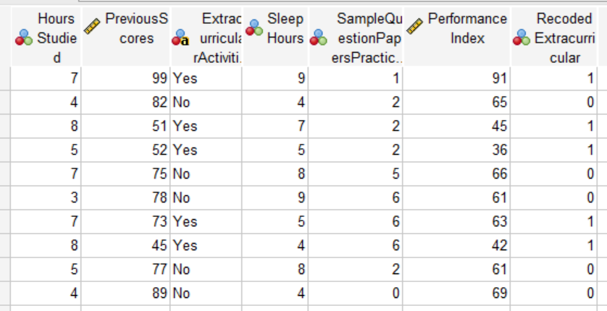
INTRODUCTION
Take a closer look at our dataset, where we explore the ingredients for student success. Traditional methods might miss out on the important details.
Our dataset examines different parts of student life, like study habits and activities, to provide a complete picture. We aim to go beyond grades, using data to understand patterns and predict success, leading to more personalized learning.
Come along as we uncover valuable insights, supporting educators and schools to better understand and assist students with a more personalized and informed approach.

Slide 4



GOALS AND OBJECTIVES
Efficiency
Innovation
Using this model we will get to know the KPI’s which affect the students’ performance and hence faculty can suggest improvements to students which can drastically improve their performance .
By getting an idea of what areas students’ are lagging behind they can manage their time by using innovative methods for improving themselves.

Slide 5

PROBLEM STATEMENT
We will be doing a project using a comprehensive regression analysis centered around the "Student Performance" dataset. We will be using this dataset and conducting a regression analysis on a dataset that aims to explore the factors influencing academic performance in a group of students.
With a collective aim to unravel the factors influencing academic achievement, our investigation explores variables encompassing study habits, academic scores, extracurricular engagements, sleep patterns, and the Performance Index as the benchmark for overall student performance.
We meticulously analyze the descriptive statistics of key variables, providing insights into the study habits, previous scores, sleep patterns, practice engagement, and participation in extracurricular activities among students. These variables, ranging from hours studied to extracurricular activities, form the bedrock of our regression analysis, offering a nuanced understanding of their impact on academic performance.

Slide 6



SYSTEM/SOFTWARE
MS EXCEL
IBM SPSS
POWER BI

Slide 7
METHOD USED
Regression analysis is a statistical method that estimates the relationship between a dependent variable and one or more independent variables.
Regression analysis answers the Questions:
Which factors matter most?
Which can we ignore?
How do those factors interact with one another?
How certain are we about all these factors?
Most companies use regression analysis to explain a phenomenon they want to understand (for example, Why did customer service calls drop last month?) predict things about the future (for example, What will sales look like over the next six months?), or to decide what to do (for example, should we go with this promotion or a different one?).

Slide 8
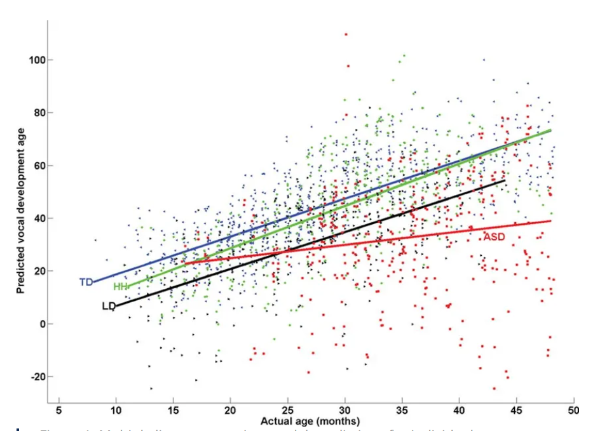
MULTIPLE LINEAR REGRESSION
Multiple linear regression refers to a statistical technique that is used to predict the outcome of a variable based on the value of two or more variables. It is sometimes known simply as multiple regression, and it is an extension of linear regression. The variable that we want to predict is known as the dependent variable, while the variables we use to predict the value of the dependent variable are known as independent or explanatory variables.

Slide 9
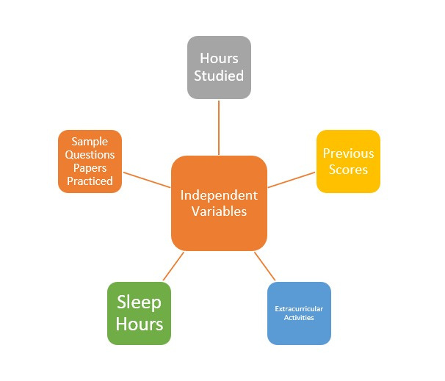
DATASET INFO
Dependent Variable: -The dependent variable is the focus of our analysis. It's the outcome or result that we are trying to predict, explain, or understand. In our dataset, the Performance Index serves as the dependent variable. This is the measure of overall student performance, and it's the value we are interested in explaining or predicting.
Independent Variables: -Independent variables are the factors or features that we believe might influence or contribute to changes in the dependent variable.

Slide 10
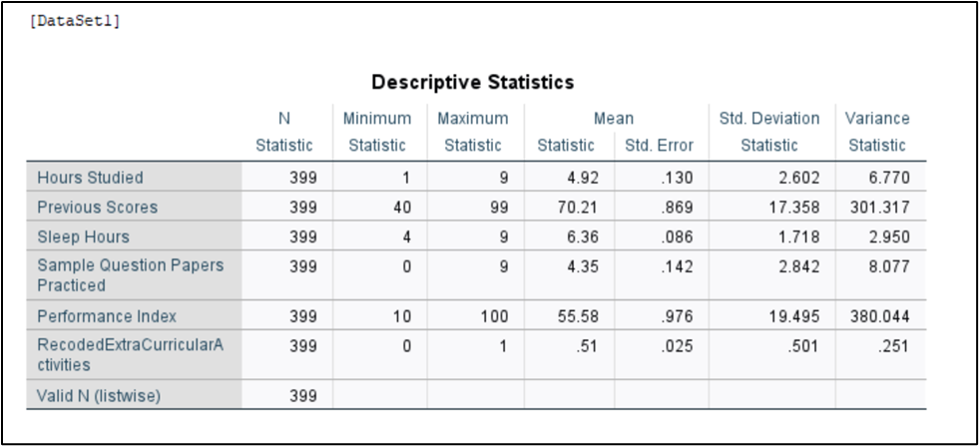
DESCRIPTIVES STATISTICS
Study Hours: Students invest an average of 4.92 hours in studying, showing variability.
Previous Scores: Scores range from 40 to 99, indicating diverse academic backgrounds.
Sleep Hours: Students average 6.36 hours of sleep, with variations.
Sample Papers Practiced: Practice varies (0 to 9),suggesting different preparation approaches.
Performance Index: Overall performance ranges widely (10 to 100), reflecting diversity.
Extracurricular Activities: A balanced participation (0.51) in extracurricular activities is observed.

Slide 11
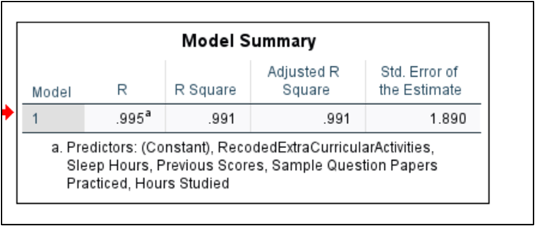
MODEL SUMMARY
The model summary table reports the strength of the relationship between the model and the dependent variable. R, the multiple correlation coefficient, is the linear correlation between the observed and model-predicted values of the dependent variable. Its large value indicates a strong relationship. In our model summary, the Adjusted R Square value is 0.991 which indicates that our model is a good fit for predictions.

Slide 12
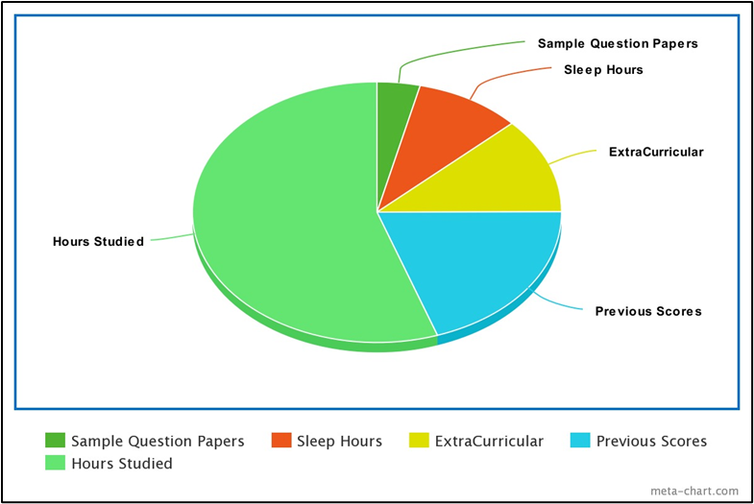
OUTPUT
This Graph Tells Us About The Significance Of The Factors Concerning The Performance Index Of The Student.
Pie Chart Helps Us To Understand The Data More By Categorizing The Findings Based On A Measurable Quantity I.E. Performance Index.
GRAPH FOR SIGNIFICANT FACTORS

Slide 13
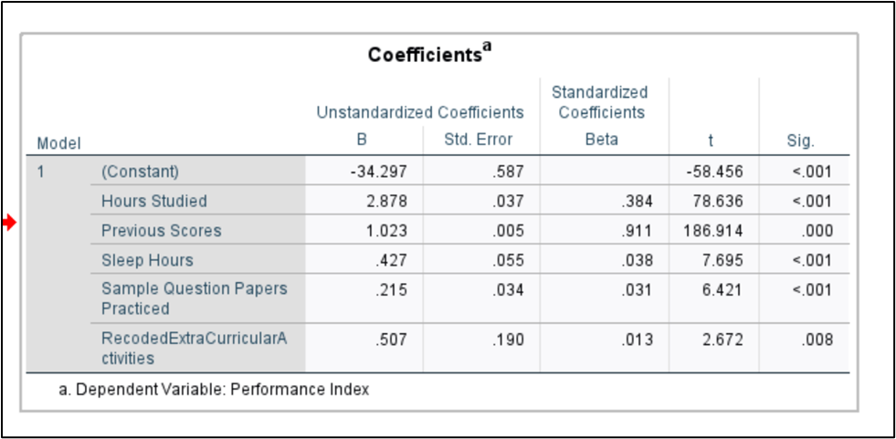
COEFFICIENTS TABLE
The value of the coefficient reflects the amount of change in the predicted preference ranking. The sign of the coefficient indicates whether the predicted response increases or decreases when the predictor increases, all other predictors being constant.
From the coefficients, we could see that previous Scores have a higher Beta coefficient. Hence, Previous scores have the highest influence on the performance Index of the student.
Performance Index = (−34.297)+(2.878×hours Studied)+(1.023×previous Scores)+(0.427×sleep Hours)+(0.215×sample Question Papers Practiced)+(0.507×recoded Extra Curricular Activities)

Slide 14

CONCLUSION
We Began Our Quest To Disentangle The Complex Network Of Variables That Influence Academic Success With Our Thorough Investigation Of The Student Performance Dataset. We Have Discovered Important Factors That Have A Major Influence On The Performance Index, A Reliable Indicator Of Students' General Academic Ability, Using Thorough Multiple Linear Regression Analysis.
To Sum Up, Our Research Has Shed Light On The Complex Interplay Between Academic And Extracurricular Aspects Of Student Success. The Secret To Academic Success Is The Combination Of Focused Study Habits, A Proven Track Record Of Accomplishment, A Healthy Lifestyle, And Deliberate Practice That Becomes A Habit. Teachers, Legislators, And Students Themselves Can Use These Insights To Create Environments That Support Academic Success As We Work To Develop A Comprehensive Understanding Of The Factors Influencing Student Performance.

Slide 15

Thank
you!

